Slide 1

ExoHabitAI
Intelligent Habitability Prediction System — Internship Project
AI | Machine Learning | Data Engineering | Full‑Stack Dashboard

Slide 2

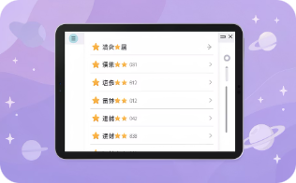

Project Overview
What it is
Main outputs
Integration
An analytics platform that evaluates planetary datasets and estimates habitability using ML.
Automated predictions, ranked analytical insights, interactive visual outputs.
End-to-end integration of data science and software engineering.

Slide 3

Problem Statement
Data Challenges
Analysis Gap
Project Goal
Traditional methods lack automation and real-time prediction capability.
Develop an AI-driven system to learn patterns and produce automated habitability predictions.
Large-scale, multi-dimensional planetary datasets that are hard to interpret manually.

Slide 4
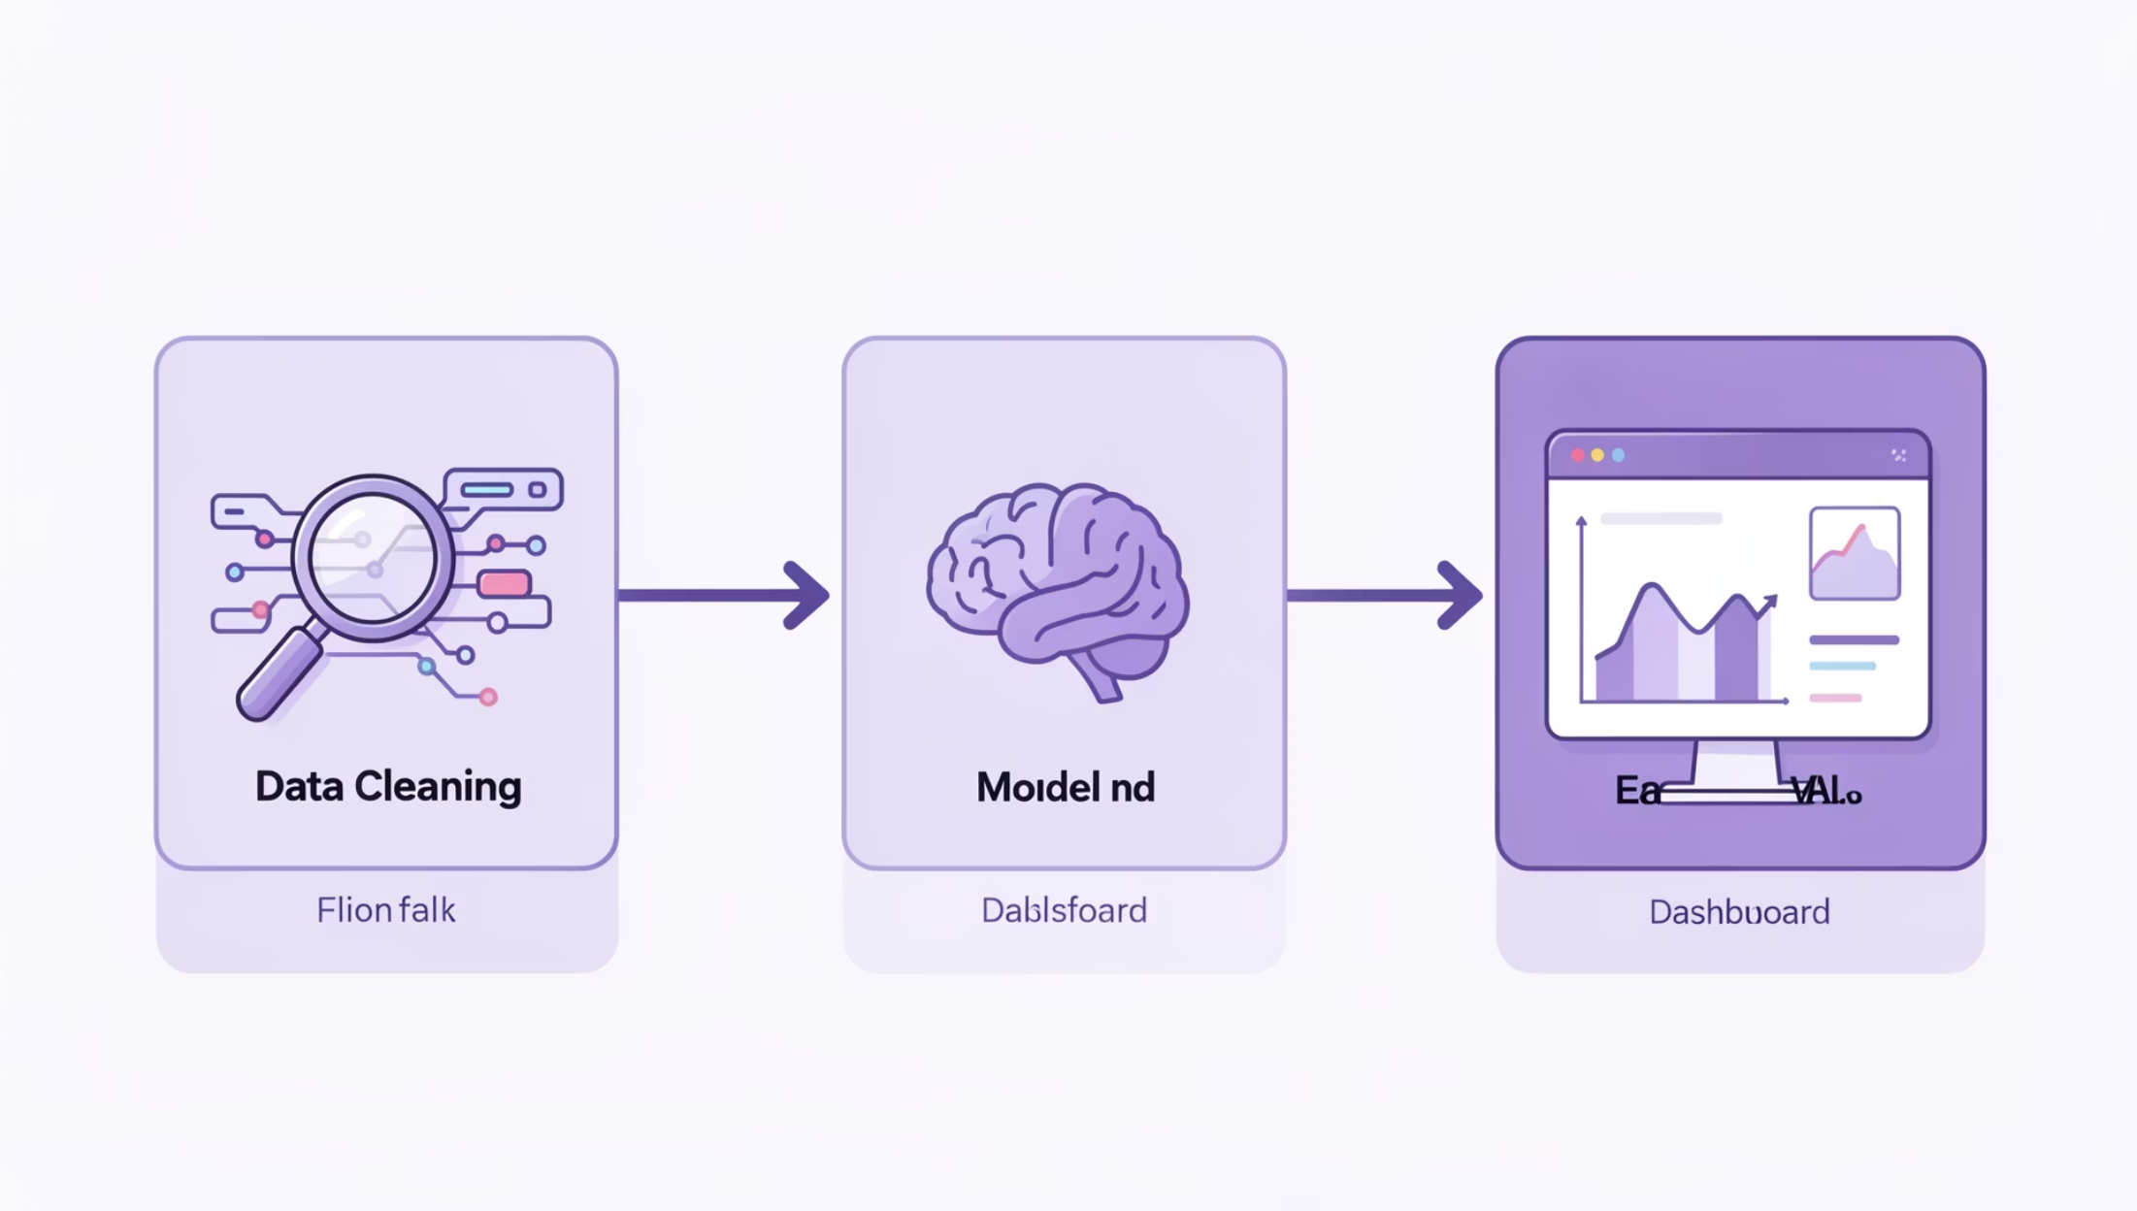
Solution Approach
01
1. Data exploration & cleaning
02
2. Scientific feature engineering
03
3. Model training & comparison
04
4. Backend API & dashboard
Transforms raw data into actionable insights via a structured AI workflow.

Slide 5
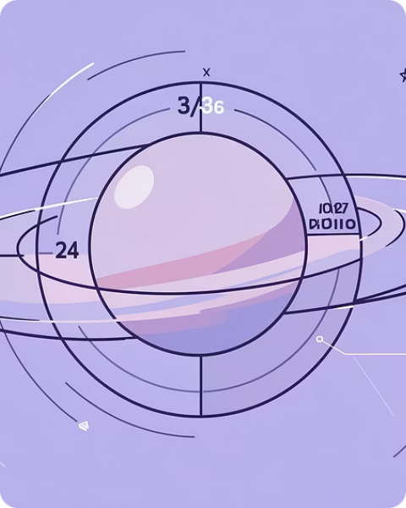
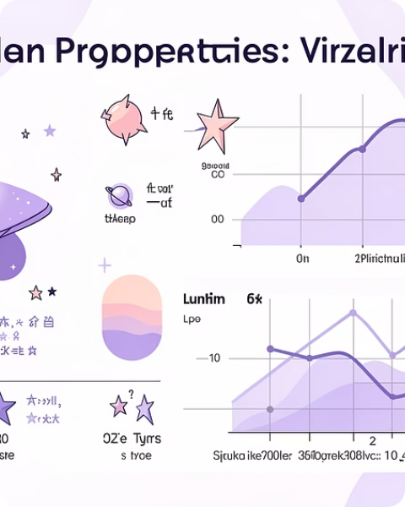
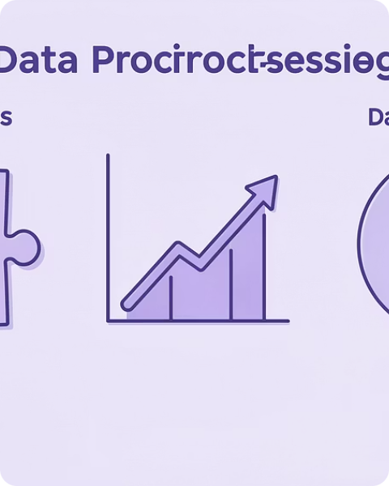
Dataset Understanding
Planetary Attributes
Stellar Properties
Preprocessing
Planet radius, orbital period, temperature and related measurements.
Host star characteristics included for context in habitability estimation.
Handle missing values, numeric scaling, feature validation, scientific filtering.

Slide 6
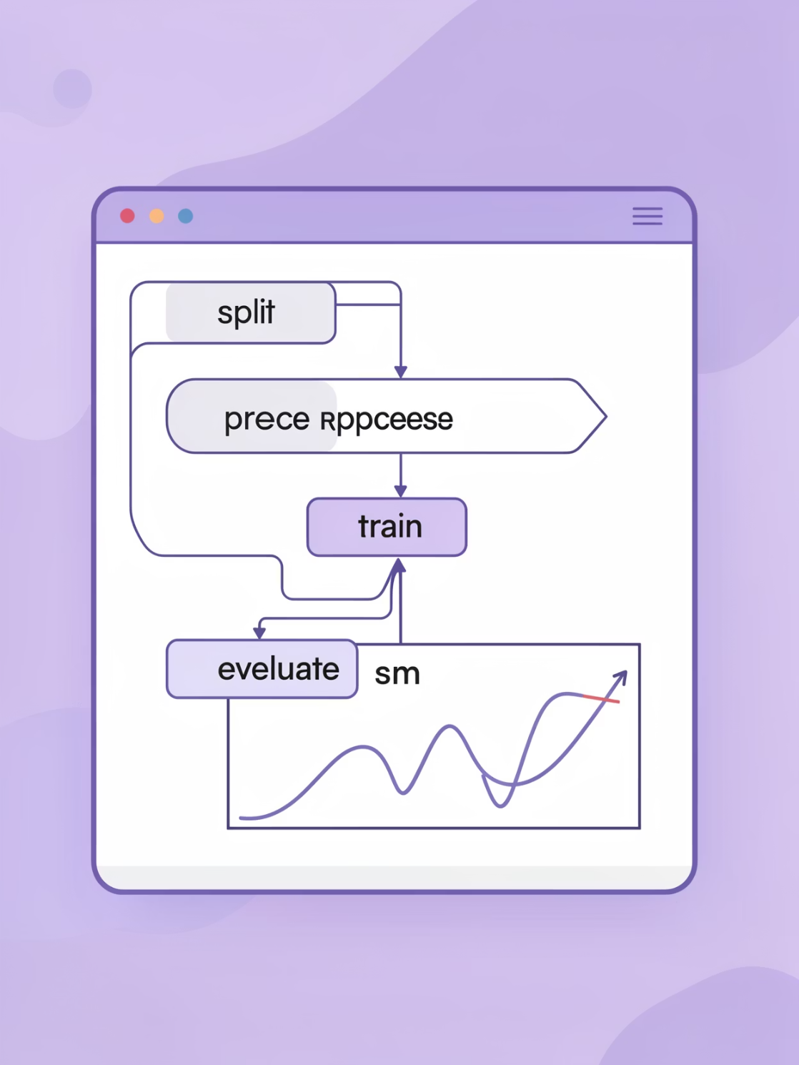
Machine Learning Pipeline
Data splitting & validation
Feature preprocessing
Model training & performance evaluation
Algorithms: Logistic Regression, Random Forest Classifier. Evaluation metric: ROC‑AUC score for probability quality.

Slide 7
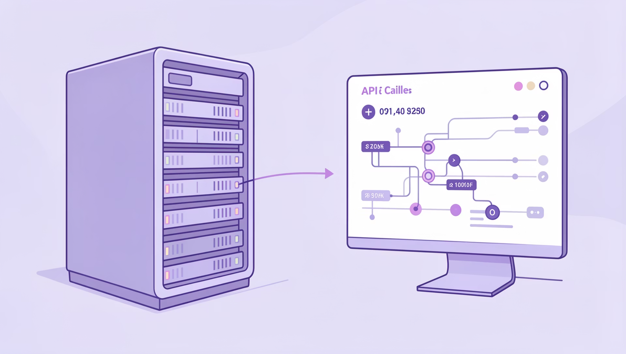
Intelligent Prediction Engine
Real-time Predictions
Accepts user parameters and returns habitability probability and classification.
Inference Flow
Input → preprocess → model → probability score → classification output.
Enables live interaction between UI and AI system for immediate insights.

Slide 8
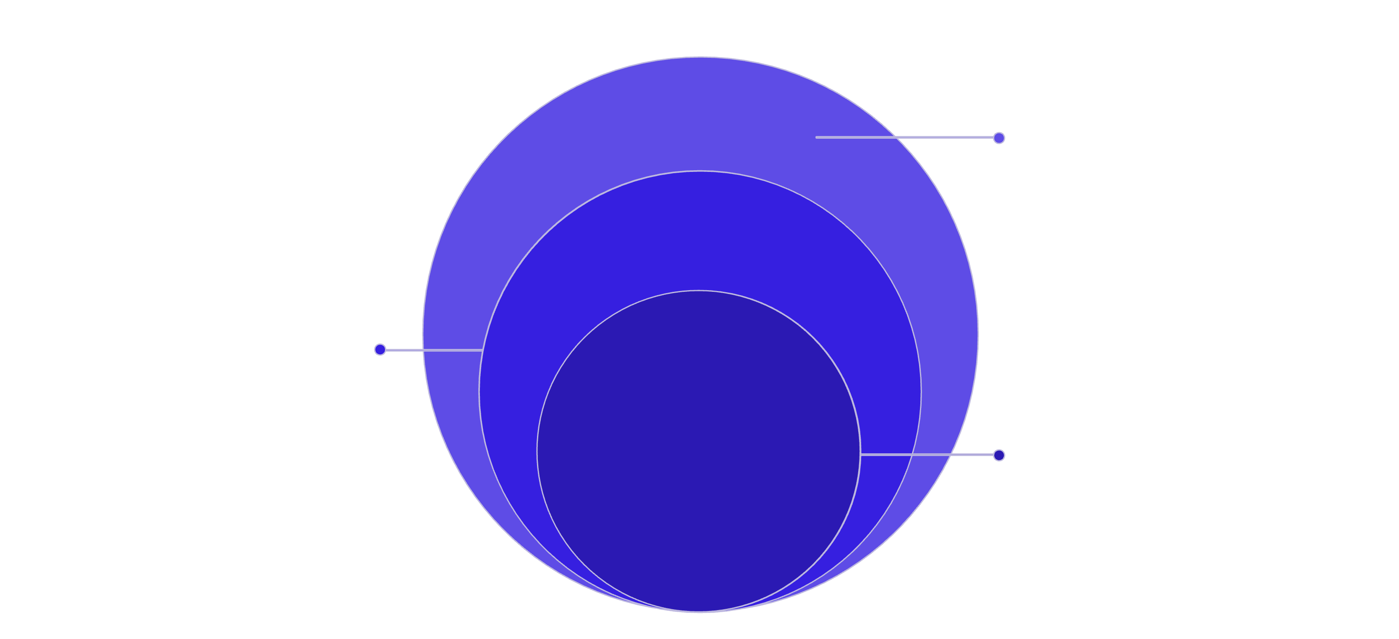
System Architecture
Interface Layer
Frontend dashboard and Backend REST API
Data Processing
Data pipelines and processing modules
Core Inference
Model inference engine and AI ranking
Frontend: interactive dashboard and visualization panels. Backend: REST API, data processing, inference. AI: trained pipeline with automated ranking logic.

Slide 9
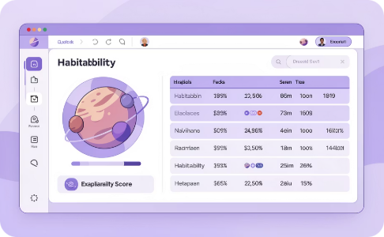
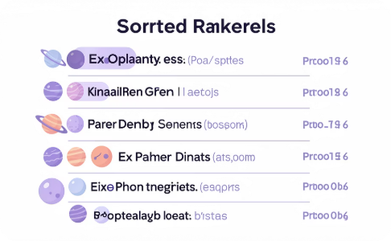
Dashboard Experience & Ranking
Dashboard Features
Ranking System
Real-time results, habitability score visualization, ranked exoplanet table, dataset statistics.
Every planet gets a probability score; dataset is auto-sorted to generate an analysis-ready ranked list for comparison and visualization.

Slide 10




Outcomes, Highlights & Next Steps
Key Achievements
Technical Highlights
Future Scope
Built full ML pipeline, implemented real-time prediction APIs, developed ranking engine, designed interactive dashboard.
Advanced neural models, automated feature selection, live streaming integration, scalable model serving.
Automated training pipeline, adaptive scoring, real‑time service, data-driven visualization layer.
ExoHabitAI demonstrates a full AI lifecycle: data exploration → model training → real-time prediction → interactive analytics, turning complex datasets into decision support.

